Slide 1
Secure data hiding in images using stegnography
CAPSTONE PROJECT
Presented By:
Student Name : Uma Maheswaran P
College Name & Department : B S Adbur Rahman University & Finance and Systems

Slide 2
OUTLINE
Problem Statement
Technology used
Wow factor
End users
Result
Conclusion
Git-hub Link
Future scope

Slide 3
Problem Statement
Hiding a message inside the image
Use of Encryption and Decryption techniques

Slide 4
Technology used
Technology used Python Script
Libraries used are CV2, OS and String

Slide 5
Wow factors
What makes this project stand out from other project(Unique features)

Slide 6
End users
Nation’s security agency will be using this for secure data sharing.
Nation’s data management agency will be using this for securing the data of the public.

Slide 7
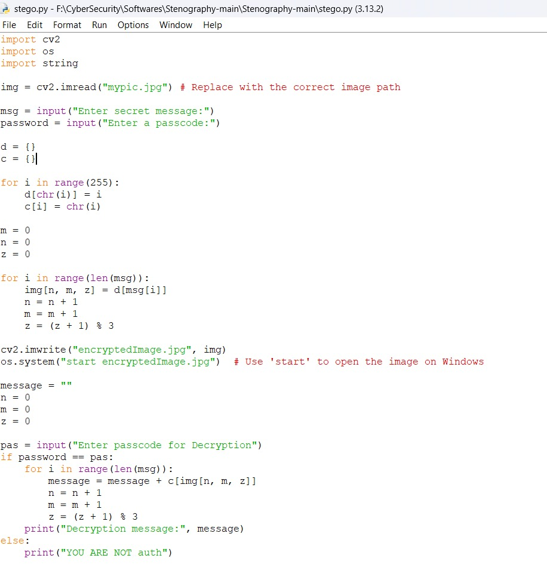
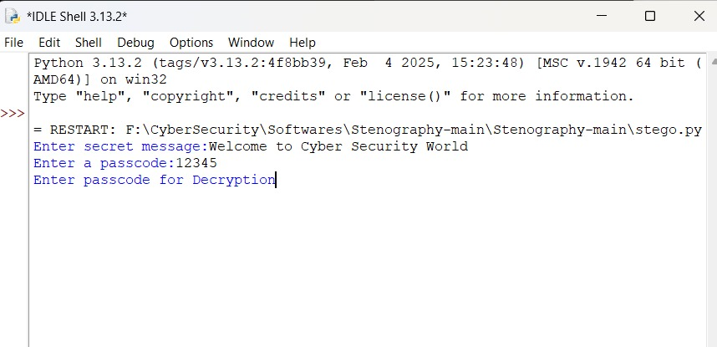
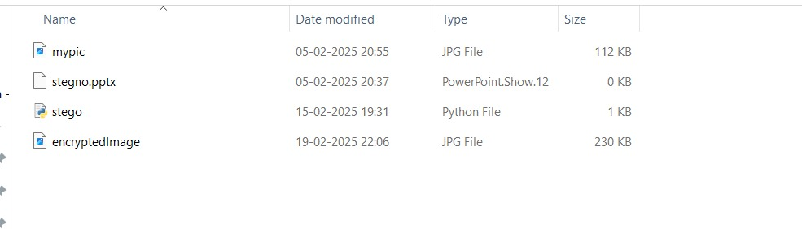
Results

Slide 8
Conclusion
Using the Python technology applied the Encryption and Decryption logic to hide a message inside a picture by protecting this with a password.

Slide 9
GitHub Link
https://github.com/um7mahesh/AICTE-B4-Internship.git

Slide 10
Future scope(optional)

Slide 11
THANK YOU

